Slide 1


Early Life Support – YOS Novara
Daily Update
Date 17th January 2023

Slide 2
Executive Summary
No major issues reported overnight.
Loss of 4G connection has been reported in the support chat. This is to be further looked at.
TC77 scanners have been switching between WiFi and 4G. The instructions to be applied to select either 4G or WiFi for the network connection.
Screensize issues have been resolved by using the zoom function for now.
Other tickets that have been discussed in the ELS call and the tickets raised today so far can be found on the next slide.

Slide 3
Key Incidents Summary – In Progress
INC # | Title | Date Opened | Assignment Workgroup | State | Comments
INC021904015 | The latest status is not getting displayed in DDS. | 17/01/2023 | FXE_Dev_EMEA_YOS | In Progress
INC021903929 | Movement on DDS with null values on it. | 17/01/2023 | FXE_Dev_EMEA_YOS | In Progress
INC021903152 | Special characters are not shown correctly on the driver departure screen. | 17/01/2023 | TNT_DEV_GLB_ROCS_INFOSYS | In Progress
INC021904319 | Duplicate Units | 17/01/2023 | FXE_Dev_EMEA_YOS | In Progress

Slide 4
Key Incidents Summary – On Hold
INC # | Title | Date Opened | Assignment Workgroup | State | Comments
INC021853088 | I have some issues looking at the driver departure screens for Novara. I don't see all units I would expect | 10/01/2023 | FXE_Dev_EMEA_YOS | On Hold | Defect raised : D-117596 . To be prioritized

Slide 5
Key Incidents Summary – Resolved & Closed

Slide 6
Appendix

Slide 7
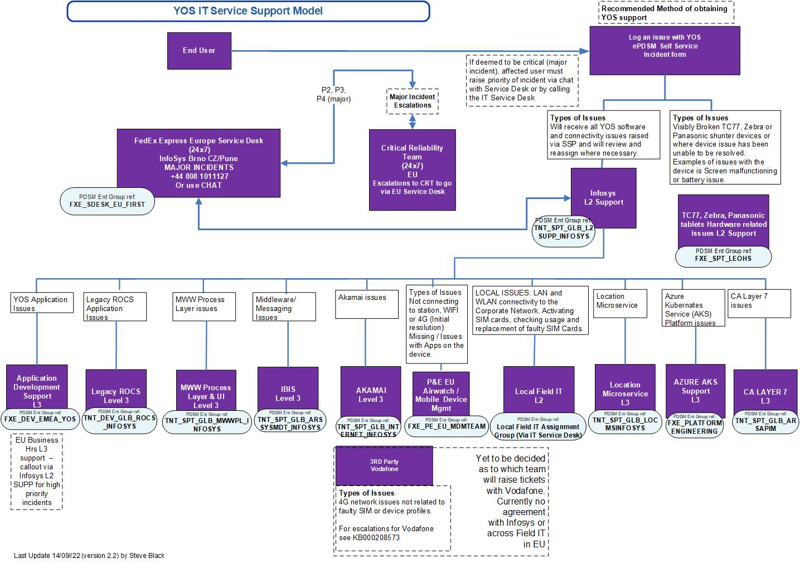
YOS Support Model

